Slide 1

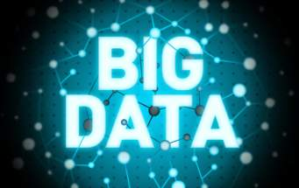
PRESENTATION ON BIG DATA
Formed by KISHAN KUMAR RAI

Slide 2
Content
What is Big Data?
Characteristic of Big Data
Why Big Data ?
Big Data sources
Tools used in Big Data
Risks of Big Data
Benefits of Big Data

Slide 3

What is BIG DATA ?
LET’S TAKE AN EXAMPLE
40 EXABYTES

Slide 4
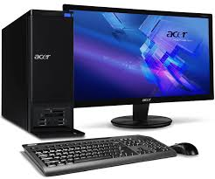

40 EXABYTES
x
5,000,000,000
= 200,000,000,000 EXABYTES
BIG DATA

Slide 5
What is BIG DATA ?
‘Big Data’ is similar to ‘small data’, but bigger in size
But having data bigger it requires different approaches: – Techniques, tools and architecture
It’s aim to solve new problems or old problems in a better way
Big Data generates value from the storage and processing of very large quantities of digital information that cannot be analyzed with traditional computing techniques.

Slide 6





Let’s have a look at data generated per minute on the internet
“2.1 Million”
“3.8 Million”
“1 Million”
That’s a lot
Of data
“4.5 Million”
“188 Million”

Slide 7
What is BIG DATA ?
Walmart handles more than 1 million customer transactions every hour.
Facebook handles 40 billion photos from its user base.
Decoding the human genome originally took 10years to process; now it can be achieved in one week.

Slide 8


How do we treat any data as big data ?
The data that can’t be processed by using traditional system.
100 MB
Attach
BIG DATA

Slide 9
Three Characteristics of Big Data
3 V’s
Volume
Velocity
Variety

Slide 10
1st Character of Big Data
Volume DATA QUANTITY
A typical PC might have had 10 gigabytes of storage in 2000.
Today, Facebook ingests 500 terabytes of new data every day.
Boeing 737 will generate 240 terabytes of flight data during a single flight across the US.
The smart phones, the data they create and consume; sensors embedded into everyday objects will soon result in billions of new, constantly-updated data feeds containing environmental, location, and other information, including video.

Slide 11
2nd Character of Big Data
Velocity DATA SPEED
Clickstreams and ad impressions capture user behavior at millions of events per second
High-frequency stock trading algorithms reflect market changes within microseconds
Machine to machine processes exchange data between billions of devices
Infrastructure and sensors generate massive log data in realtime
On-line gaming systems support millions of concurrent users, each producing multiple inputs per second.

Slide 12

It has lots of glitch.

Slide 13
3rd Character of Big Data
Variety DATA TYPES
Big Data isn't just numbers, dates, and strings. Big Data is also geospatial data, 3D data, audio and video, and unstructured text, including log files and social media.
Traditional database systems were designed to address smaller volumes of structured data, fewer updates or a predictable, consistent data structure.
Big Data analysis includes different types of data.

Slide 14
The Structure of Big Data
Structured
Unstructured
Semi-structured

Slide 15
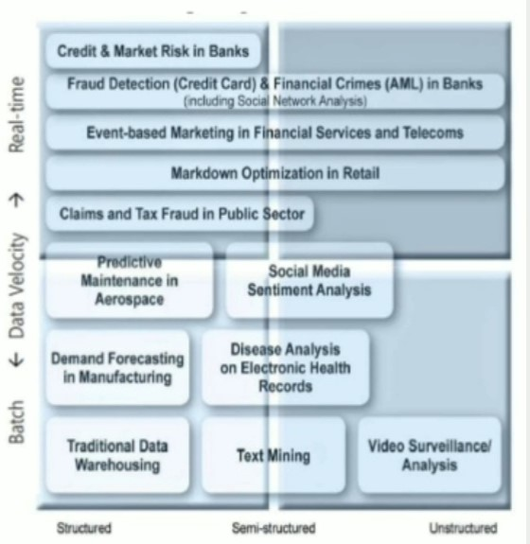
The Structure of Big Data
STRUCTURED DATA
Most traditional data sources
SEMI-STRUCTURED
Many sources of big data
UNSTRUCTURED
Video data ,audio data

Slide 16
Why BIG DATA ?
Growth of Big data is needed
Increase of storage capacities.
Increase of processing power.
Availability of data(different data types).
Every day we create 2.5 PB of data; 90% of the data in the world,
today has been created in the last two years alone.

Slide 17
Big data sources
Big data files
Users
Applications
System sensors

Slide 18
Types of tools used in Big-data
Where processing is hosted?
Distributed servers/ cloud.
Where data is stored?
Distributed storage.
What operations are performed on data ?
Analytic/ semantic processing .

Slide 19
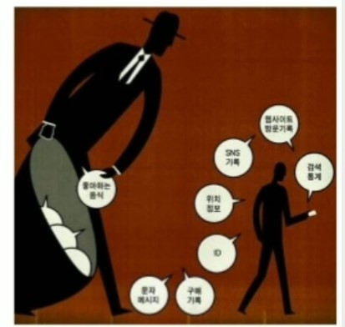
Risks of Big Data
Will be so overwhelmed.
Need the right people and solve the right problems.
Costs escalate too fast.
Isn’t necessary to capture 100%.
Many sources of big data is
privacy.
Self- regulation.
Legal regulation.

Slide 20
Benefits of Big Data
Real-time big data isn’t just a process for storing petabytes or exabytes of data in a data warehouse. It’s about the ability to make better decisions and take meaning actions at the right time.
Fast forward to the present and technologies like Hadoop give you the scale and the flexibility to store data before you know how you are going to process it.

Slide 21
References
www.slideshares.com
www.Wikipedia.com
www.computereducation.org
Books-
Big Data by Victor Mayer-Schonberger

Slide 22
THANK YOU !

